Slide 1
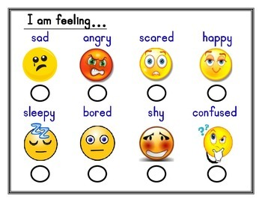
Feelings Helper Procedure
Child is off-task or disruptive
Ask child to complete Feelings Helper Worksheet
  Two feelings: angry & embarrassed; silly & bored
They cannot return to the activity until they complete it fully.
The “feelings helper” checks the paper and assists them to complete the plan (if needed)
At the end of the day or activity, they circle if the plan worked.
Teacher adds a happy face ☺ or question mark (?) at the end.

Slide 2
Feelings Helper (Young Students)

Slide 3
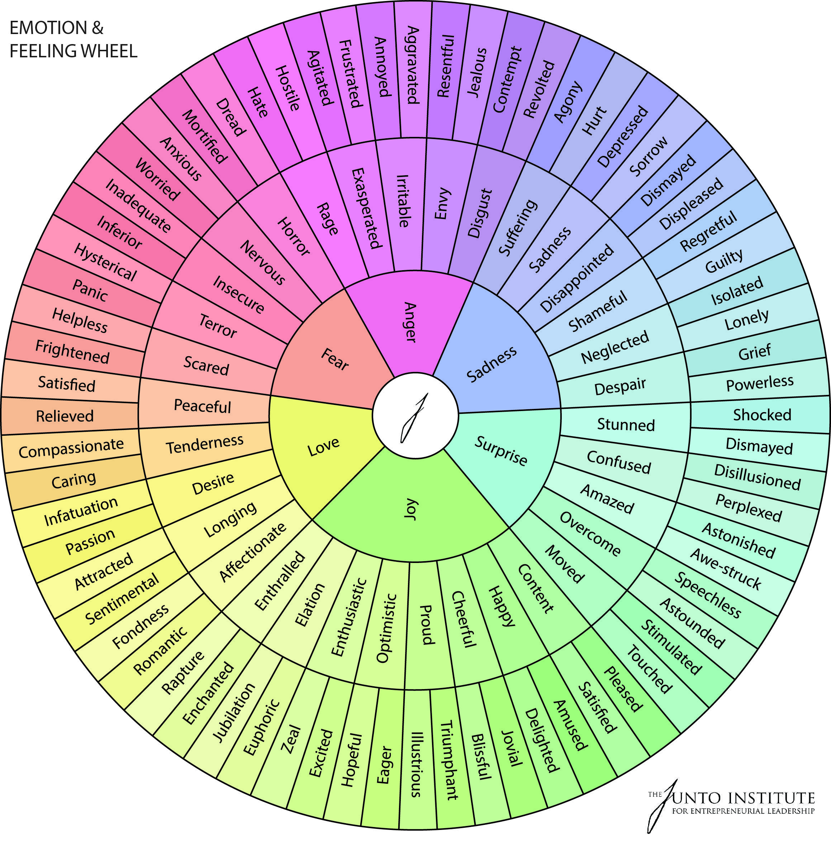
Feelings Helper Older Students
I feel ______________________________
I also feel___________________________
I feel like this because_________________ _________________________________________________________________________________________________________
I need to feel________________________
Therefore, I will______________________ ____________________________________________________________________________________________________________________________________________

Slide 4
The Feelings Helper: A Classroom Job
Helps peer's complete worksheet
Generate ideas for the plan
Help child carry out the plan if needed
Checks if the plan worked
Yes: draw ☺
No: draw (?) and
Ask child why it did not work
Tell the child to write why it did not work on the back

